Slide 1
Software Design and Architecture
Activity Diagrams

Slide 2
Activity Diagrams
Activity diagrams describe the workflow behavior of a system.
The diagrams describe the state of activities by showing the sequence of activities performed.
Activity diagrams can show activities that are conditional or parallel.

Slide 3
The main reason to use activity diagrams is to model the workflow behind the system being designed.
Diagrams are read from top to bottom and have branches and forks to describe conditions and parallel activities.
A fork is used when multiple activities are occurring at the same time.

Slide 4
Activity diagrams are constructed from a limited set of shapes, connected with arrows. The most important shape types:
  rounded rectangles represent activities;
  diamonds represent decisions;
  bars represent the start (split) or end (join) of concurrent activities;
  a black circle represents the start (initial state) of the workflow;
  an encircled black circle represents the end (final state).
  Arrows run from the start towards the end and represent the order in which activities happen.

Slide 5
Activity Diagram
Important for modeling system functions.
Emphasizes the flow of objects and synchronization of the flow in support of parallel processing.
An extension of the old "flow chart" diagram.

Slide 6
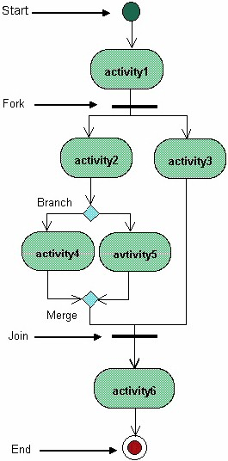

Slide 7

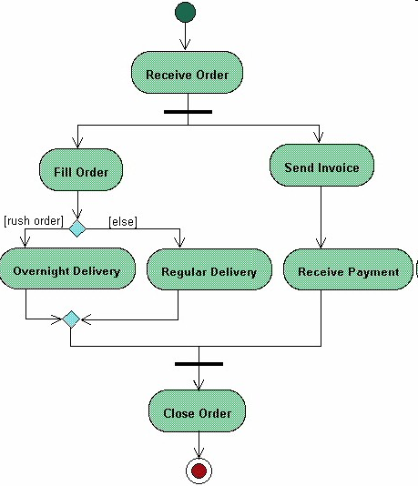
Example-1: Processing an Order

Slide 8
Swim Lanes
A swim lane (or swimlane) is a visual element used in process flow diagrams, or flowcharts, that visually distinguishes responsibilities for sub-processes of a business process.
Parallel lines divide the chart into lanes, with one lane for each person, group or subprocess. Lanes are labelled to show how the chart is organized.

Slide 9
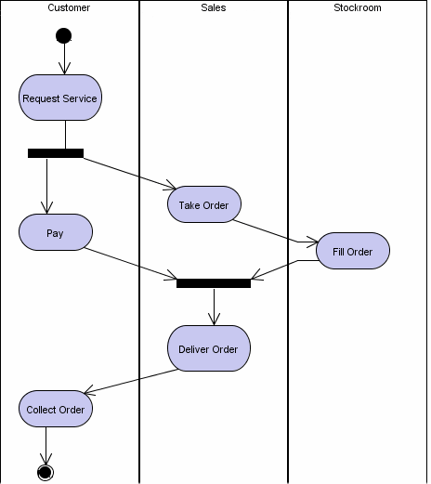
Example-2: Processing an Order

